Slide 1
X-ray Multi-Classified Preprocessing, Visualization, and Model Design
Nick Calabro, Anthony Klimas, Luke MacVicar, Hilary Jaen Rodriguez

Slide 2
Data Overview
Source: NIH Chest X-ray 14
Originally 1024 x 1024 or higher
112,120 images
We aim to achieve competitive accuracy (within 5%) of modern models on this problem
Additional metadata:
Age
Gender
Number of followup doctor visits
Chest X-ray orientation
Original resolution

Slide 3
EDA Insights
True Count Mean: 5798.286
Standard Deviation: 5429.592
Imbalance is clearly quite large with a range of 19,667

Slide 4
EDA Insights
Image resolution is not standardized
Often too high
Depending on training time, we’ll experiment with resolution size
Baseline will use a consistant 224 x 244 resolution
Likely diminishing returns in accuracy as the resolution increases
Early training cycles starting with small resolution may detect broader features
Increase resolution as training epochs increase

Slide 5
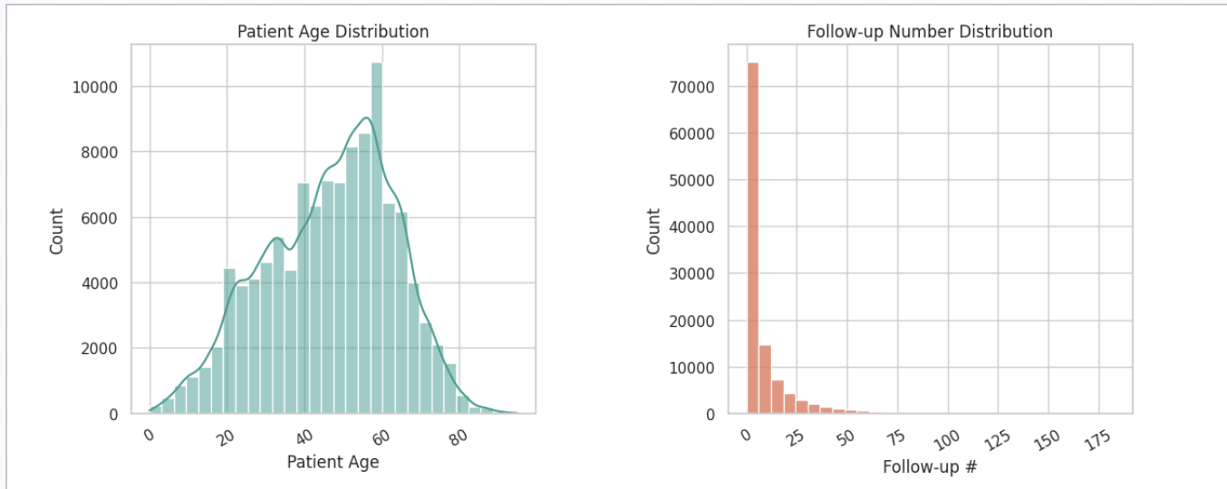
Data Visualizations
Patient Age Distribution: This shows the ages of each patient involved in the dataset. We see that most fall between the ages of 50 and 60 years old
Follow-up Number Distribution: Shows how many of these images are from follow ups. Which is a very small number meaning most of these are from unique patients.

Slide 6
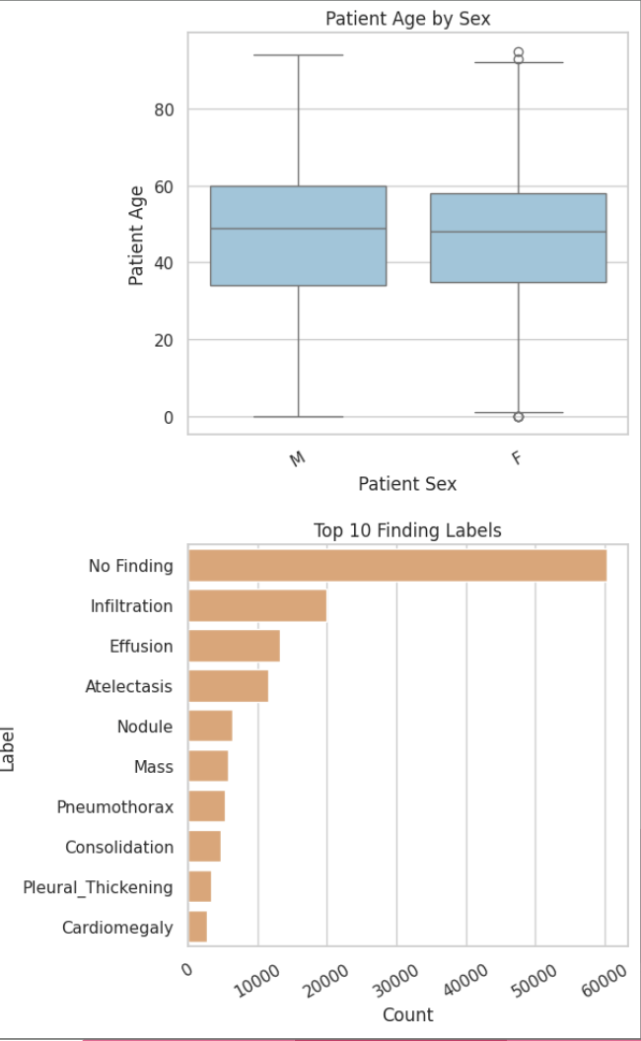
Data Visualizations
Patient Age by sex shows the distribution of the ages for the patients distinguished by sex
Top 10 findings shows what the distribution of findings across the data set

Slide 7
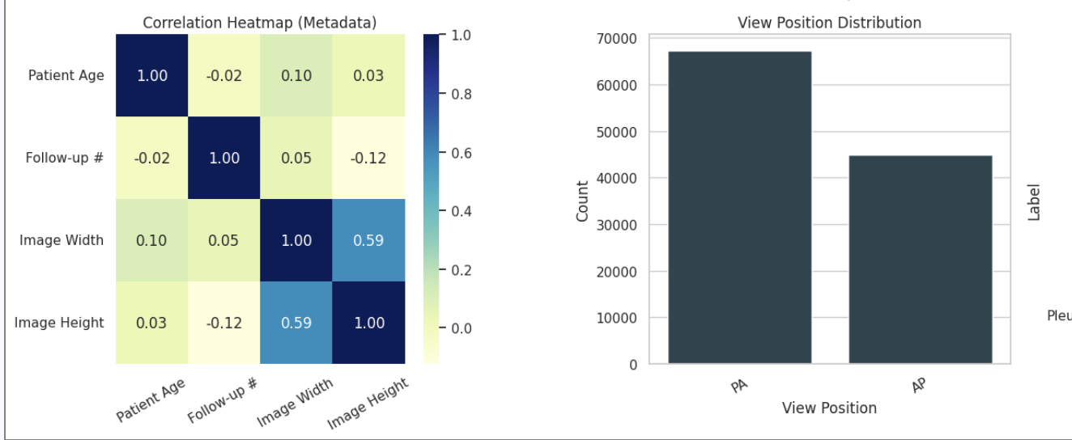
Data Visualizations
Correlation Heatmap shows how related these aspects of the data are.
The view position distribution is demonstrating which images are from each xray position

Slide 8
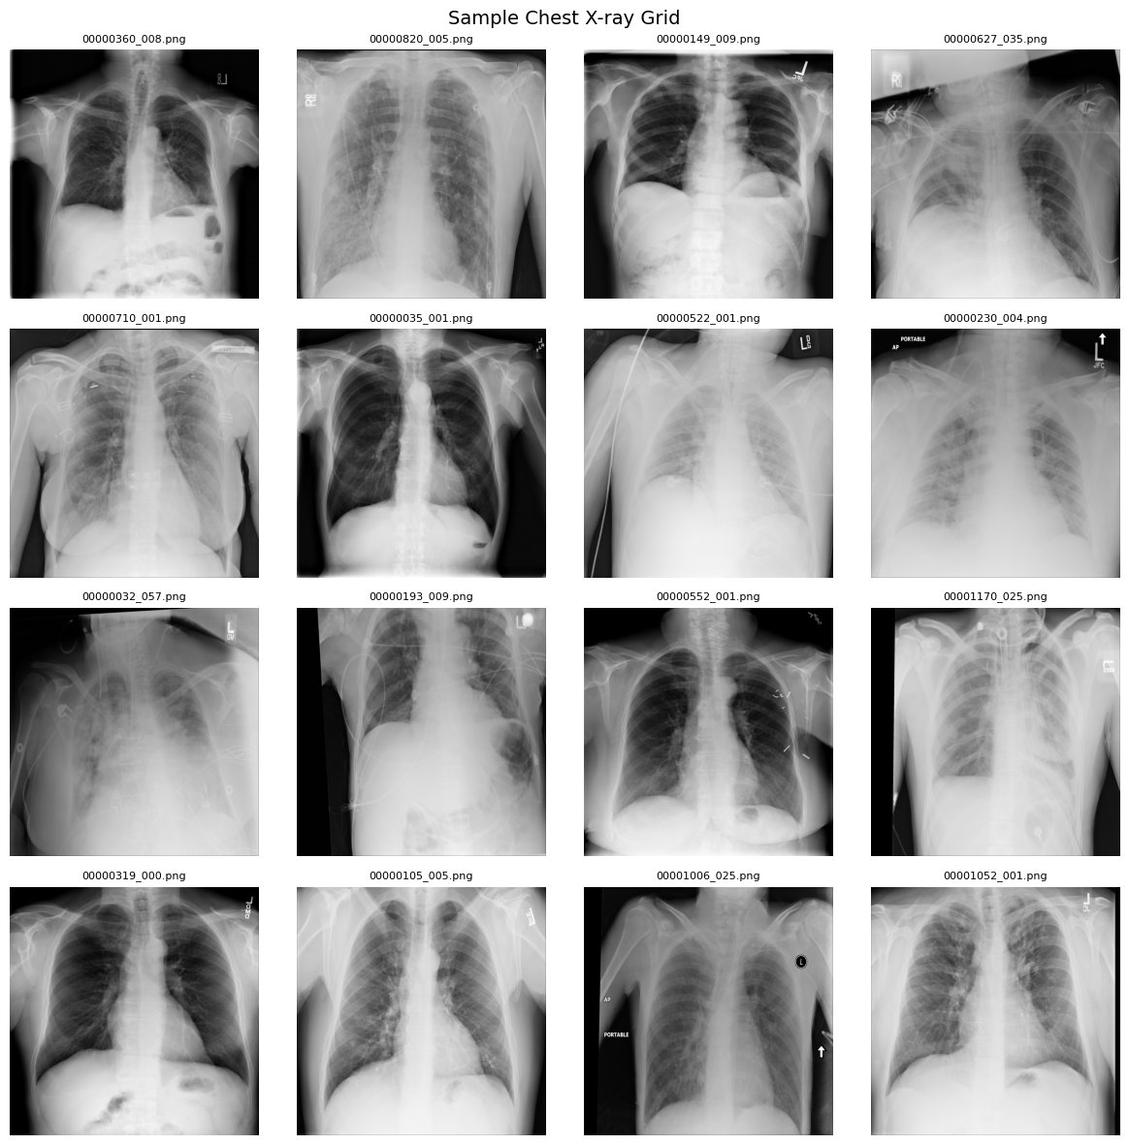
X-ray Grid
This is the raw preprocessed data
It is important to see and understand the data we are working with before putting it into the CNN

Slide 9
Challenges
Class Imbalance:
Some disease appear much more frequently than others, which can cause the model to favor common classes and perform poorll on rare ones
Multi-Label Complexity
Each X-ray image can contain multiple diseases, requiring the model to predict several labels at once instead of just one.
Label noise
The dataset labels were generated automatically, which may introduce errors and reduce overall data quality.

Slide 10
Next Steps
Data preprocessing (resize, normalize): We will preprocess the data by resizing images to a standard size and normalizing pixel values to improve model training efficiency.
Data augmentation (flip, rotate): We will apply data augmentation techniques such as flipping and rotating images to increase data diversity and improve generalization. Handle imbalance (class weights): To address class imbalance, we will use techniques such as class weighting to ensure the model does not favor more frequent diseases.
Model training (Swin Transformer): We will train a Swin Transformer model to effectively capture both local and global patterns in the images for improved classification performance.

